Slide 1
Chapter 8
Tables

Slide 2
Overview
How tables are used
Basic table structure
Importance of headers
Spanning rows and columns
Cell padding and spacing
Accessibility

Slide 3
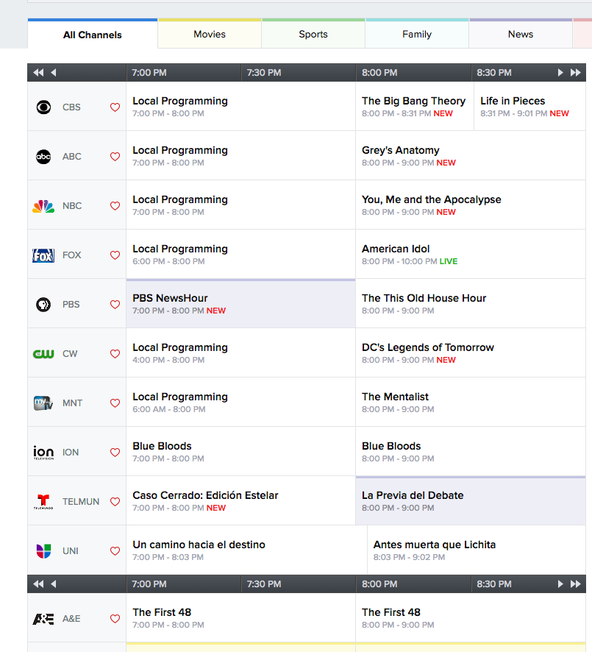
How are tables used
When you need to add tabular material
data arranged into rows and columns
May be used to organize calendars, schedules, stats, or other types of info
Back in the old days, tables were used to make multi-columned layouts on webpages, but no more.
Notes:
Show google drive/webpages/web page 2002-2008

Slide 4
Problems with tables
Large tables difficult to view on mobile devices
Need to consider logical layout to accommodate users who may be hearing the data read aloud
Remember screenreader video…

Slide 5
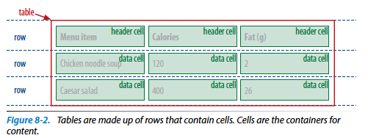
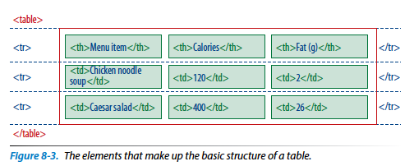
Minimal Table Structure

Slide 6

Code to generate the table
<table>
<tr>
<th>Menu item</th>
<th>Calories</th>
<th>Fat (g)</th>
</tr>
<tr>
<td>Chicken noodle soup</td>
<td>120</td>
<td>2</td>
</tr>
<tr>
<td>Caesar salad</td>
<td>400</td>
<td>26</td>
</tr>
</table>

Slide 7
Can you draw this table?
<table>
<tr>
<td>Sufjan Stevens</td>
<td>Illinoise</td>
<td>Asthmatic Kitty Records</td>
</tr>
<tr>
<td>The Shins</td>
<td>Oh Inverted World</td>
<td>Sub-pop Records</td>
</tr>
</table>

Slide 8
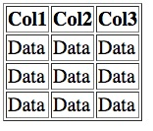
Try to recreate this:

Slide 9
Table Headers
Text marked up as headers <th>is displayed differently from other cells in the table
Exactly how they display is dependent on the browser
Headers are important – provide information or context about cells in row or column
Headers are a key tool for making table content accessible
Don’t try to fake headers by formatting a row of td elements differently from the rest!!
Also, don’t avoid using th elements because of their default rendering (bold and centered).
Mark headers semantically and change presentation with style rule

Slide 10
Spanning Cells
Stretching of a cell to cover several rows or columns
Allows you to create complex table structures
Makes markup a little more difficult
Use colspan or rowspan attributes

Slide 11
Column span
Used as an attribute in the td or th elements
Stretches a cell to the right to span over the subsequent columns
<table>
<tr>
<th colspan=“2">Fat</th>
</tr>
<tr>
<td>Saturated Fat (g)</td>
<td>Unsaturated Fat (g)</td>
</tr>
</table>

Slide 12
Row span
Used as an attribute in the td or th elements
Stretches a cell downward over several rows
<table>
<tr>
<th rowspan="3">Serving Size</th>
<td>Small (8oz.)</td>
</tr>
<tr>
<td>Medium (16oz.)</td>
</tr>
<tr>
<td>Large (24oz.)</td>
</tr>
</table>

Slide 13
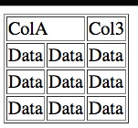
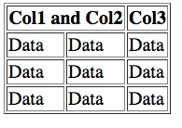
Try to recreate these:

Slide 14
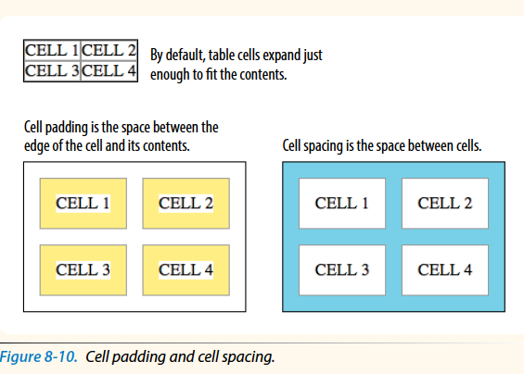
Space in and between cells

Slide 15
Advanced Table Elements
More elements and attributes that offer more complex semantic descriptions and improve accessibility
Row group elements – describe rows or groups of rows using thead, tfoot, tbody
May also be used to apply styles to various regions of table
Column group elements (col or colgroup)– used to identify columns
add semantic context to information
doesn’t appear on page, just describes columns before table data begins

Slide 16
Example
<table>
<caption>Nutritional Information (Calorie and Fat Content)</caption>
<col span="1" class="itemname">
<colgroup id="data">
<col span="1" class="calories">
<col span="1" class="fat">
</colgroup>
<thead>
<tr>
<th scope="col">Menu item</th>
<th scope="col">Calories</th>
<th scope="column">Fat (g)</th>
</tr>
</thead>
<tbody>
<tr>
<td>Chicken noodle soup</td>
<td>120</td>
<td>2</td>
</tr>
<tr>
<td>Caesar salad</td>
<td>400</td>
<td>26</td>
</tr>
</tbody>
</table>

Slide 17
Accessibility
Need to consider non-sighted users
Tabular data is challenging, but there are measures you can take to improve the experience and make content more understandable
Describing table content
Connecting cells and headers

Slide 18
Describing Table Content
Use caption element to give table title or brief description of contents
caption element must be first thing within the table element

Slide 19
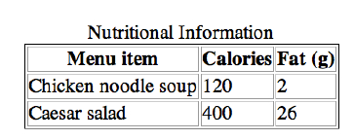
Example
<table>
<caption>Nutritional Information</caption>
<tr>
<th>Menu item</th>
<th>Calories</th>
<th>Fat (g)</th>
</tr>
…table continues…
</table>

Slide 20
Connecting cells and headers
Sometimes it’s difficult to know which header applies to which cells
may be at the left or right edge of a row rather than top of column
scope attribute associates a table header with the row, column or group of rows
headers attribute used in the td element to explicitly tie it to a header’s id value
not going into detail on this one

Slide 21
Making pretty tables
Various attributes and styles you can set
border – sets border width in pixels
cellpadding – sets space inside the cell
cellspacing – sets space outside the cell
backgroundColor – used in style to set the background color of an element
color – used in style to set the color of text

Slide 22
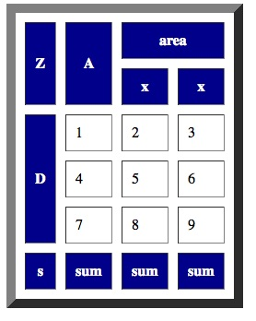
Generate code

